Slide 1

AI Architecture Design
Group: Chế độ độc tài UI-UX
Bui Dang Quy – 20225995
Pham Quang Anh – 20220071
Vu Ngoc Dung – 20226032
Le Minh Nam – 20226059
Nguyen Duc Anh – 20226009

Slide 2
Table of Contents
Introduction
Business process
Message
Prototype

Slide 3
INTRODUCTION

Slide 4
1. Introduction
A user-friendly web application combining Direct Manipulation and 3D Visualization
Interactive Workspace is used to intuitively arrange furniture by homeowners via Drag & Drop
Smart Search Engine is used to support "Recognition over Recall" for rapid asset retrieval

Slide 5
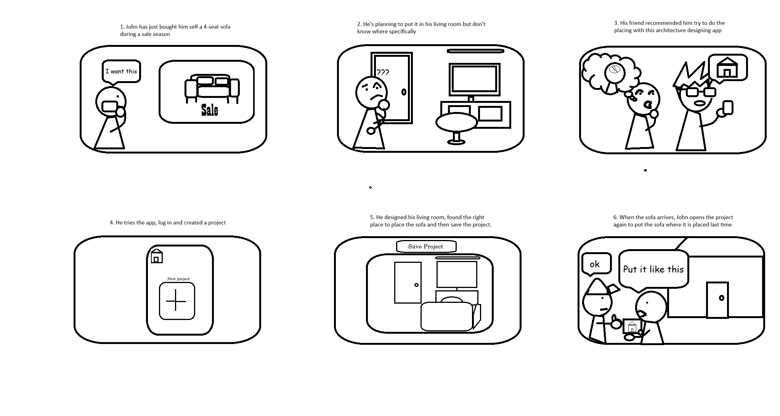
1. Introduction
Storyboard

Slide 6
BUSINESS PROCESS

Slide 7
2. Business Process
Requirement Definition: Users define their needs and preferences to establish the initial design context.
AI-Driven Generation: The system translates user's text prompts into 3D drafts using Generative Models

Slide 8
2. Business Process
Contextual Loading: Architects retrieve the AI draft into the Interactive Workspace to analyze the layout.
Layout Optimization: Architects modify the spatial arrangement using Direct Manipulation and Smart Search tools
Resource Integration: Architects personalize the design by Importing external high-fidelity models (.obj) into the library

Slide 9
MESSAGE

Slide 10
3. Message
Building Dreams, Designing Realities

Slide 11
PROTOTYPE

Slide 12
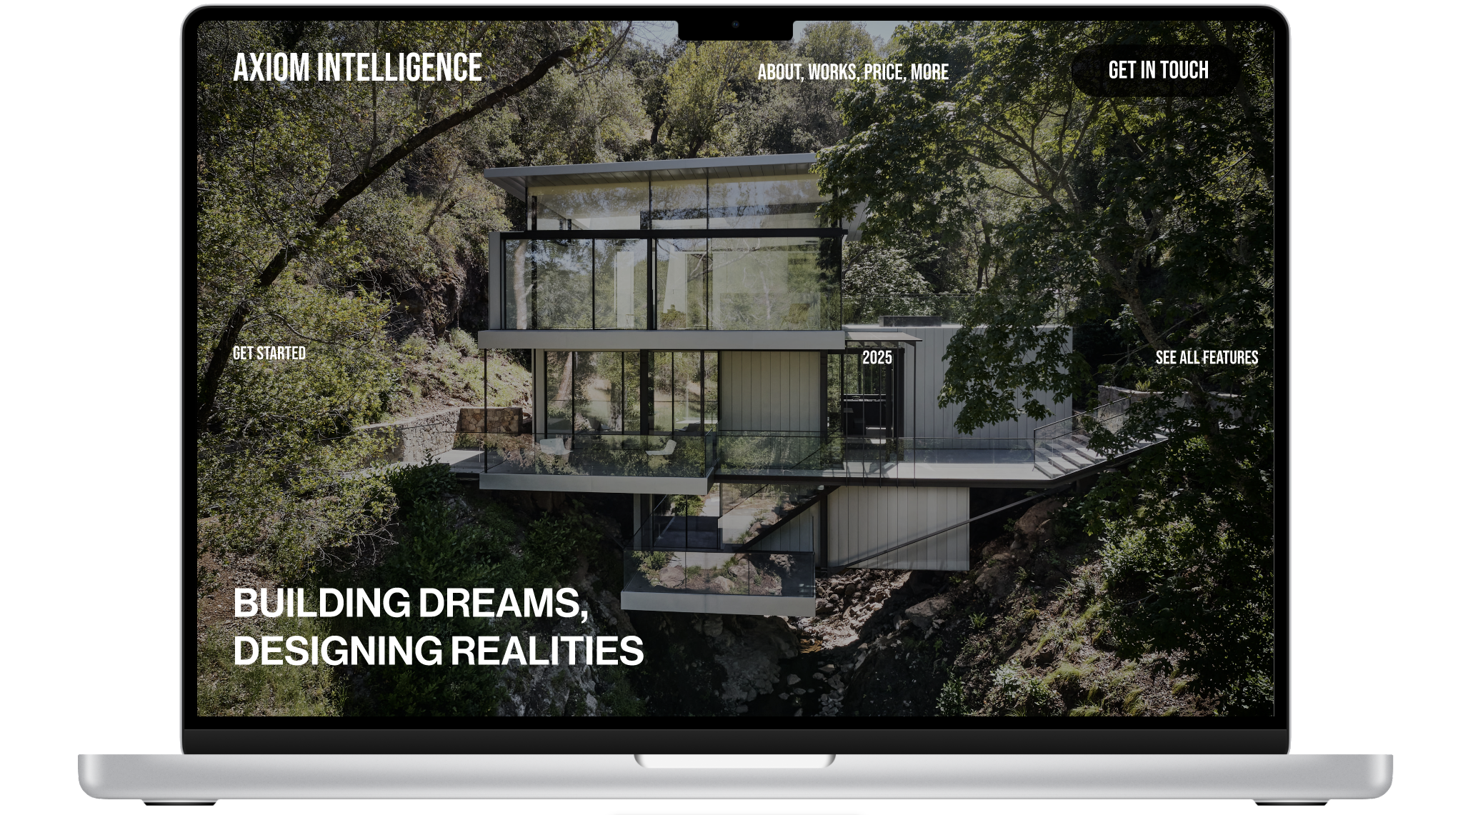
4. Prototype

Slide 13
THANK YOU !

